Slide 1
Hands-on Model Calibration in R
Eva A. Enns & Fernando Alarid-Escudero
40th Annual North American Meeting of the
Society for Medical Decision Making
October 14, 2018

Slide 2
The DARTH Workgroup
Materials for this workshop were developed in part by the Decision Analysis in R for Technologies in Health (DARTH) Workgroup
Goals: To expand knowledge in decision analysis using R and develop educational materials to empower people to construct R-based decision models.
For more information
www.darthworkgroup.com
Tweet: @DARTHworkgroup

Slide 3
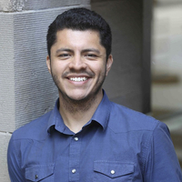
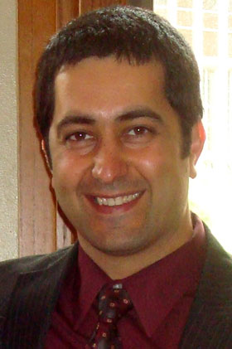




The DARTH Workgroup
F. Alarid-Escudero PhD H. Jalal MD PhD E. Enns PhD
E. Krijkamp PhDc M. Hunink MD P. Pechlivanoglou PhD

Slide 4
Motivation
Mathematical models of disease often involve a subset of parameters whose values are unknown
Common reasons include physical, feasibility, and ethical limitations
Estimate values for these parameters by matching model outputs to observed outcomes
Model calibration

Slide 5
Calibration definition
Process of adjusting model input parameter values to match data on an outcome of interest (e.g., survival, prevalence, or incidence)
Outcome(s) of interest = “calibration targets”

Slide 6
Calibration Process
KNOWN PARAMETERS
MODEL
OBSERVABLE HEALTH OUTCOMES
UNKNOWN PARAMETERS
Try different sets of parameter values
Compare against calibration targets
(Calculate “fit”)
Repeat to find “best-fitting”
set of parameter values

Slide 7
Calibration Targets
Empirical data to be replicated by the model
Summary statistics (e.g. mean age of cancer diagnosis) or series of observations (e.g. age-specific incidence)
Can calibrate to multiple targets (e.g. survival and prevalence) simultaneously
Model should be able to output the outcomes of interest
Notes:
Different from the data you’d use for validation

Slide 8
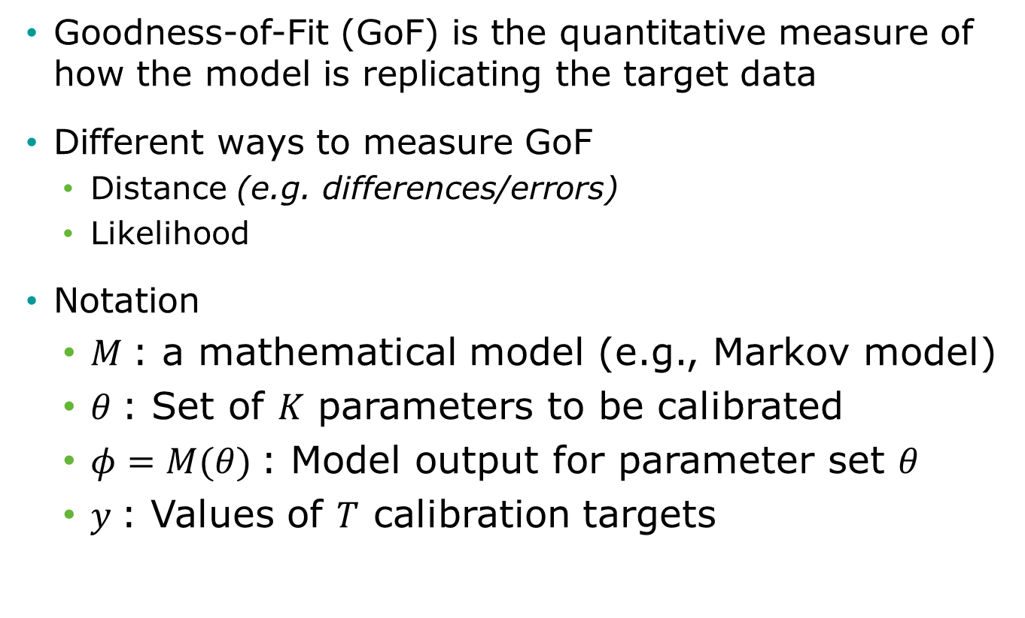
Calculating “fit”
Goodness-of-Fit (GoF) is the quantitative measure of how the model is replicating the target data
Different ways to measure GoF
Distance (e.g. differences/errors)
Likelihood
Notation
$M$: a mathematical model (e.g., Markov model)
$θ$: Set of $K$ parameters to be calibrated
$φ=M(θ)$: Model output for parameter set $θ$
$y$: Values of $T$ calibration targets

Slide 9
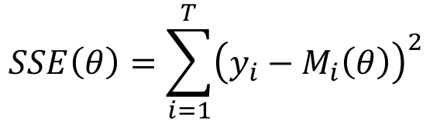
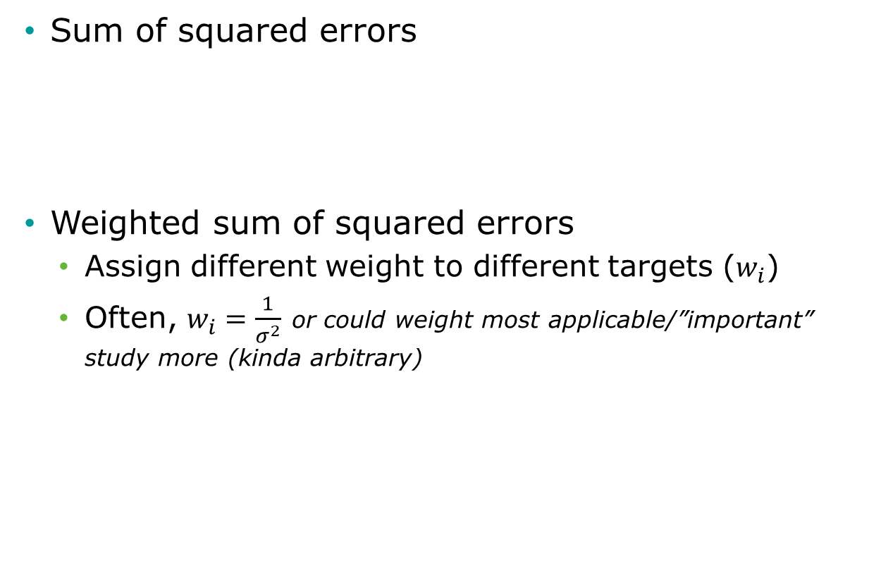
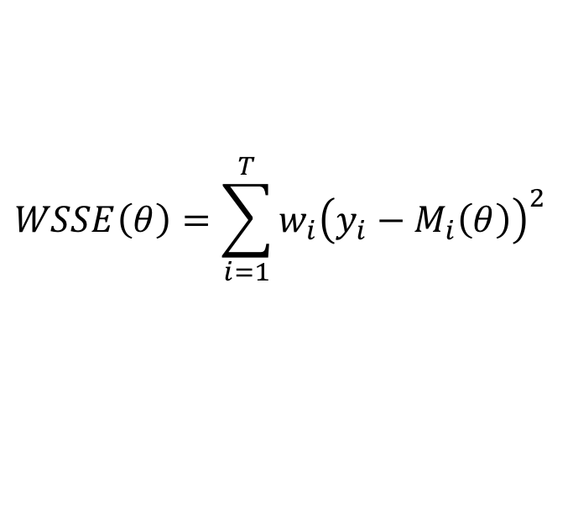
Distance GoF measures
Sum of squared errors
Weighted sum of squared errors
Assign different weight to different targets ($w_{i}$)
Often, $w_{i}=\frac{1}{σ^{2}}$ or could weight most applicable/”important” study more (kinda arbitrary)
$$SSE\left(θ\right)=\sum_{i=1}^{T}{{\left(y_{i}−M_{i}\left(θ\right)\right)}^{2} }$$
$$WSSE\left(θ\right)=\sum_{i=1}^{T}{{w_{i}\left(y_{i}−M_{i}\left(θ\right)\right)}^{2} }$$

Slide 10
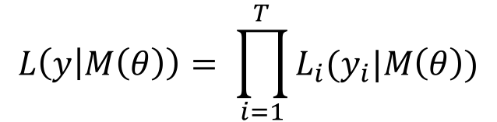
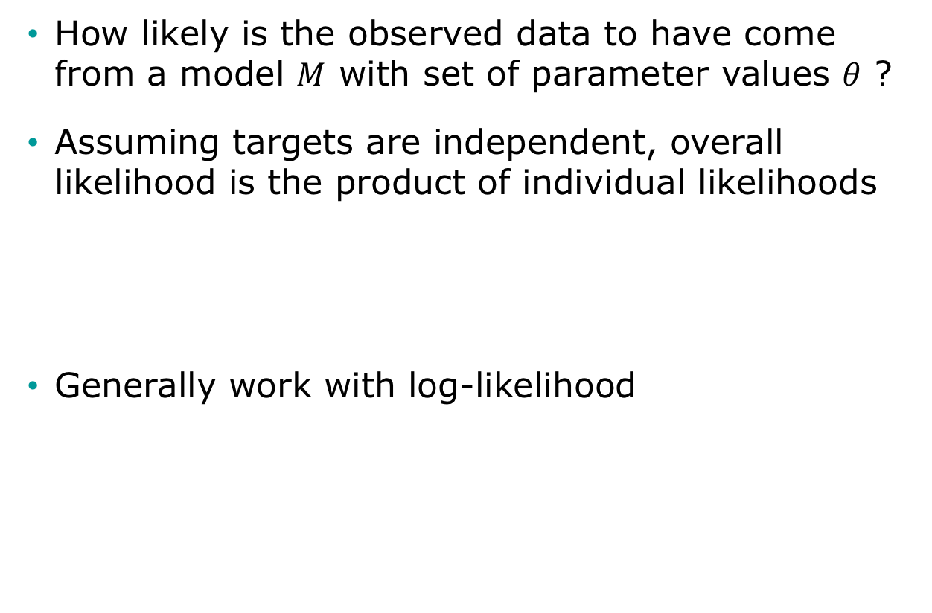
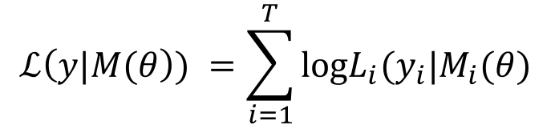
Likelihood as GoF
How likely is the observed data to have come from a model $M$ with set of parameter values $θ$ ?
Assuming targets are independent, overall likelihood is the product of individual likelihoods
Generally work with log-likelihood
$$L\left(y | M\left(θ\right)\right)= \prod_{i=1}^{T}{L_{i}(y_{i}|M\left(θ\right))}$$
$$ℒ\left(y|M(θ\right)) =\sum_{i=1}^{T}{\text{log}L_{i}(y_{i}|M_{i}(θ) }$$

Slide 11
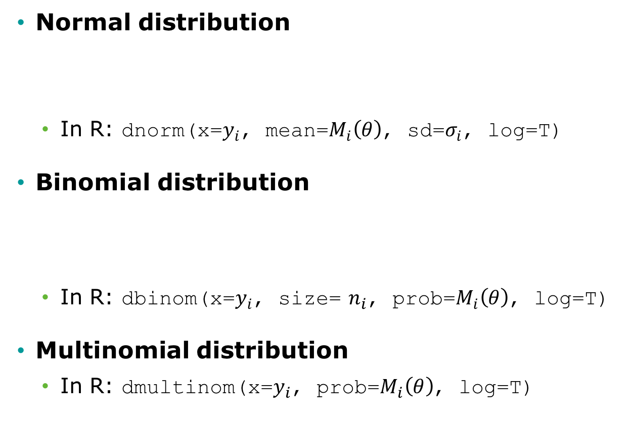
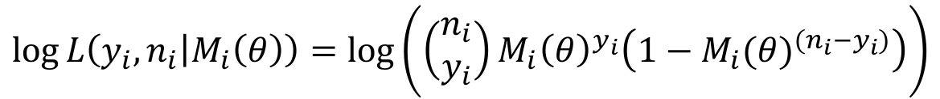
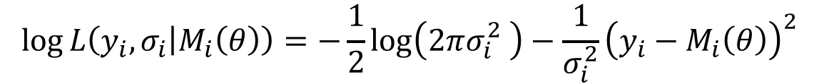
Commonly used likelihoods
Normal distribution
In R: dnorm(x=$y_{i}$, mean=$M_{i}\left(θ\right)$, sd=$σ_{i}$, log=T)
Binomial distribution
In R: dbinom(x=$y_{i}$, size= $n_{i}$, prob=$M_{i}\left(θ\right)$, log=T)
Multinomial distribution
In R: dmultinom(x=$y_{i}$, prob=$M_{i}\left(θ\right)$, log=T)
$$\log{L\left(y_{i},σ_{i} | M_{i}\left(θ\right)\right)}=−\frac{1}{2}\log\left(2πσ_{i}^{2} \right)−\frac{1}{σ_{i}^{2}}{\left(y_{i}−M_{i}\left(θ\right)\right)}^{2}$$
$$\log{L\left(y_{i},n_{i} | M_{i}\left(θ\right)\right)}=log⁡\left(\left(\begin{matrix}n_{i} \\ y_{i}\end{matrix}\right){M_{i}\left(θ\right)}^{y_{i}}\left(1−{M_{i}(θ)}^{(n_{i}−y_{i})}\right)\right)$$
Notes:
How likely is that target to have come from the model w/ these parameters?
Mostly we use the normal distribution – can be used for almost everything.
Prevalence could use the binomial distribution
Prevalence of multiple stages/subtypes of disease could use multinomial to account for dependencies.
i would be different time points

Slide 12
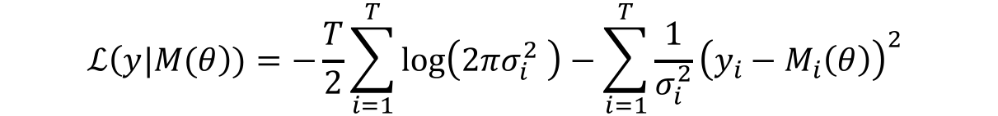

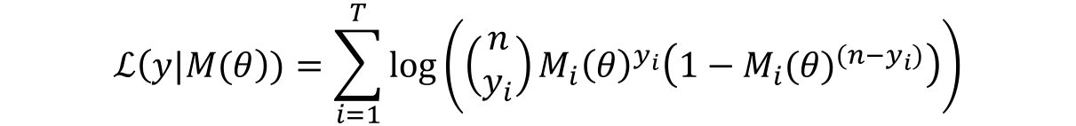
Commonly used likelihoods
Normal distribution
In R: dnorm(x=$y_{i}$, mean=$M_{i}\left(θ\right)$, sd=$σ_{i}$, log=T)
Binomial distribution
In R: dbinom(x=$y_{i}$, size=1, prob=$M_{i}\left(θ\right)$, log=T)
Multinomial distribution
In R: dmultinom(x=$y_{i}$, prob=$M_{i}\left(θ\right)$, log=T)
$$ℒ\left(y|M(θ\right))=−\frac{T}{2}\sum_{i=1}^{T}{\log\left(2πσ_{i}^{2} \right)}−\sum_{i=1}^{T}{\frac{1}{σ_{i}^{2}}{\left(y_{i}−M_{i}\left(θ\right)\right)}^{2} }$$
$$ℒ\left(y|M(θ\right))=\sum_{i=1}^{T}{\log\left(\left(\begin{matrix}n \\ y_{i}\end{matrix}\right){M_{i}\left(θ\right)}^{y_{i}}\left(1−{M_{i}(θ)}^{(n−y_{i})}\right)\right)}$$

Slide 13
Search Strategy
Define plausible ranges for parameter whose values are unknown
Use a search strategy to “search” through the input parameter space
Run the model for sets of parameter values generated by search strategy
Parameter space

Slide 14
Grid Search
Run model for all possible combinations of parameter values
Often infeasible (for > 2 parameters)

Slide 15
Random Search
Randomly sample a large number of parameter value sets from probabilistic distributions
Use "Latin hypercube sampling” (LHS) to ensure sample captures the full parameter space
Random sample

Slide 16
Random Search
Randomly sample a large number of parameter value sets from probabilistic distributions
Use "Latin hypercube sampling” (LHS) to ensure sample captures the full parameter space
LHS sample
Notes:
Good place to start. If you use the algorithms correctly, and have enough samples, this should yield the same solution as Nelder Mead
Random search can be faster if NM isn’t efficient or model is hard to evaluate many times or you have a microsim
Random search can be nice because you get multiple good fitting parameters (NM you just get one) – but you would usually pick the best one. What to do with the others? They could be really bad fits…can’t just use them in sensitivity analysis. Best approach is to go to Bayesian framework. But it’s nice to start w/ a random search to make sure model works, debug, see what’s happening, etc. Bayesian framework is only valid way to do sensitivity analysis on your calibration output.
Random search can be quite fast if you use parallel computing, NM only runs in series by construction (although you could run different NMs in parallel)

Slide 17
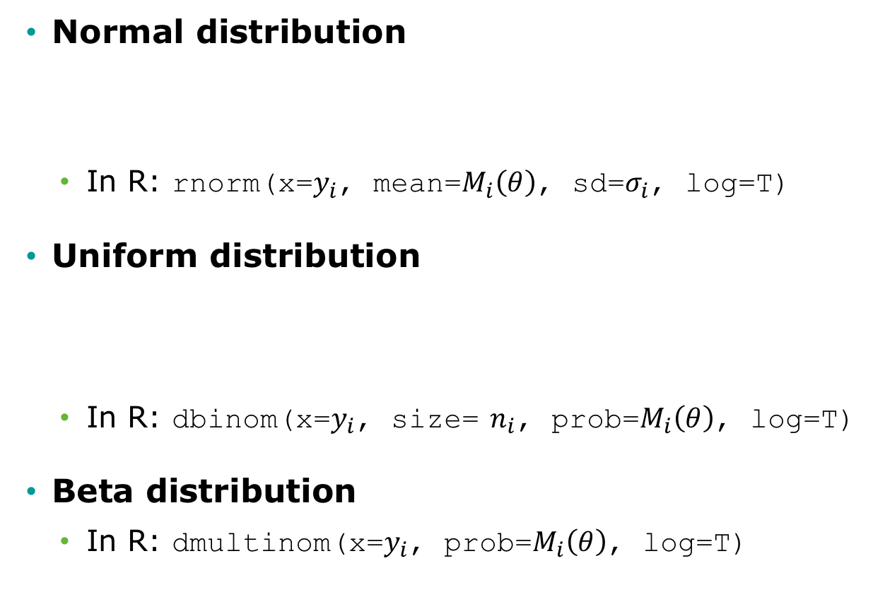
Commonly used distributions
Normal distribution
In R: rnorm(x=$y_{i}$, mean=$M_{i}\left(θ\right)$, sd=$σ_{i}$, log=T)
Uniform distribution
In R: dbinom(x=$y_{i}$, size= $n_{i}$, prob=$M_{i}\left(θ\right)$, log=T)
Beta distribution
In R: dmultinom(x=$y_{i}$, prob=$M_{i}\left(θ\right)$, log=T)
$$\log{L\left(y_{i},σ_{i} | M_{i}\left(θ\right)\right)}=−\frac{1}{2}\log\left(2πσ_{i}^{2} \right)−\frac{1}{σ_{i}^{2}}{\left(y_{i}−M_{i}\left(θ\right)\right)}^{2}$$
$$\log{L\left(y_{i},n_{i} | M_{i}\left(θ\right)\right)}=log⁡\left(\left(\begin{matrix}n_{i} \\ y_{i}\end{matrix}\right){M_{i}\left(θ\right)}^{y_{i}}\left(1−{M_{i}(θ)}^{(n_{i}−y_{i})}\right)\right)$$

Slide 18
Iterative Search
Use fits of past input values to determine which input values to try next
Directed methods (use information about goodness of fit function – e.g. MLE, following slopes/looking for peaks)
Nelder-Mead (simplex method)
Gradient–descent and others
Meta-heuristic algorithms (algorithms that seem to work but less theory behind them, not guaranteed to work/no proof they’ll work)
Genetic algorithms think of sets of model inputs as individuals in a population, they choose to reproduce w/ one another based on “fitness” (e.g. fitness to targets) to create a new set of inputs that takes best elements of the two
Simulated annealing metallurgical
These algorithms have tuning parameters that need to be “tuned” to your particular problem – involves fiddling
Notes:
This is essentially an optimization problem.

Slide 19
Nelder-Mead Algorithm
Downhill simplex method
Must be run multiple times for different starting points to avoid local extrema
starting point
final value
search path
Notes:
-Could in fact have 2 peaks (if not enough targets, or targets not defined well enough – e.g. when you have 2 equations and many unknowns) w/ same GOF (non-identifiability). This doesn’t happen frequently. When it does, Bayesian calibration is a good alternative (to determine which of the 2 peaks is best)
-OR one of the peaks could be a local optimum, but its GOF could be lower (then you pick the best peak)
Randomly pick starting points within the prior parameter range
Nelder Mead can take a very long time on a microsim because of stochasticity (could be on a path going up, but randomly goes down on 1 run bc of stochasticity). It can also run into issues if your sample space is very small.
Taking the top 100 NM results makes no sense. You will just have the same point or two points and 1 will only be local. Could use the 2 peaks as scenario analysis (?)
Would NM be faster if we could save the paths so we know not to visit those same areas?

Slide 20
Example: Calibrating a 3-state cancer model
Notes:
Part 1 = Showing code 3 state model
Part 2 = Exercise build Sick-Sicker model
Part 3 = Show answers of Sick-Sicker

Slide 21
3-state cancer model
Relative survival as reported by the Surveillance, Epidemiology, and End Results (SEER) Program, represents cancer survival in the absence of other causes of death
Cancer Markov models often have a distant metastasis state, a state not directly observed in SEER, from which cancer deaths are presumed to occur
These models are used to model interventions that affect transitions to and from this state
Alarid-Escudero, F., Maclehose, R. F., Peralta, Y., Kuntz, K. M., & Enns, E. A. (2018). Non-identifiability in model calibration and implications for medical decision making. Medical Decision Making 2018;38(7):810–21. doi:10.1177/0272989X18792283.

Slide 22
3-state cancer model
Two unknown transition probabilities
p.Mets: Monthly risk of developing distant recurrence, range = [0.04, 0.16]
p.DieMets: Monthly risk of cancer death, range = [0.04, 0.16]
Notes:
-This isn’t Bayesian calibration – so it’s better to call these plausible ranges, not priors. But you could have a prior that is uniform in this range. If you do call it a prior, this would be considered an informed prior bc you are constraining it.
-You can see that the two probabilities could exactly balance one another (colinear) if we have just a deaths target. So we will get 2 optimal parameter sets in calibration.

Slide 23
Target: Relative survival
Data frame “Surv” stored in data file “CRSTargets.RData”

Slide 24
Calibration specification
Goodness-of-fit measure
Sample size and standard deviation of each target is given in target data frame “Surv”
We will use log-likelihood as the GoF measure
Search strategy
Latin-hypercube random sampling (10,000 samples)
We’ll also show how to use Nelder-Mead

Slide 25
Calibration Code Structure
Setup Markov model as a function
Inputs: parameter values
Outputs: outcomes to be compared against calibration targets
Write function to compute goodness-of-fit
Inputs: set of values for parameters to be calibrated
Outputs: goodness-of-fit for the resulting model outcomes to the calibration targets
Randomly sample values for parameters to be calibrated and run goodness-of-fit function for each set
Identify the set of parameter values that achieves the best goodness-of-fit
Find best set using a directed search approach

Slide 26
R Session
Notes:
Part 1 = Showing code 3 state model
Part 2 = Exercise build Sick-Sicker model
Part 3 = Show answers of Sick-Sicker

Slide 27
Bayesian calibration

Slide 28
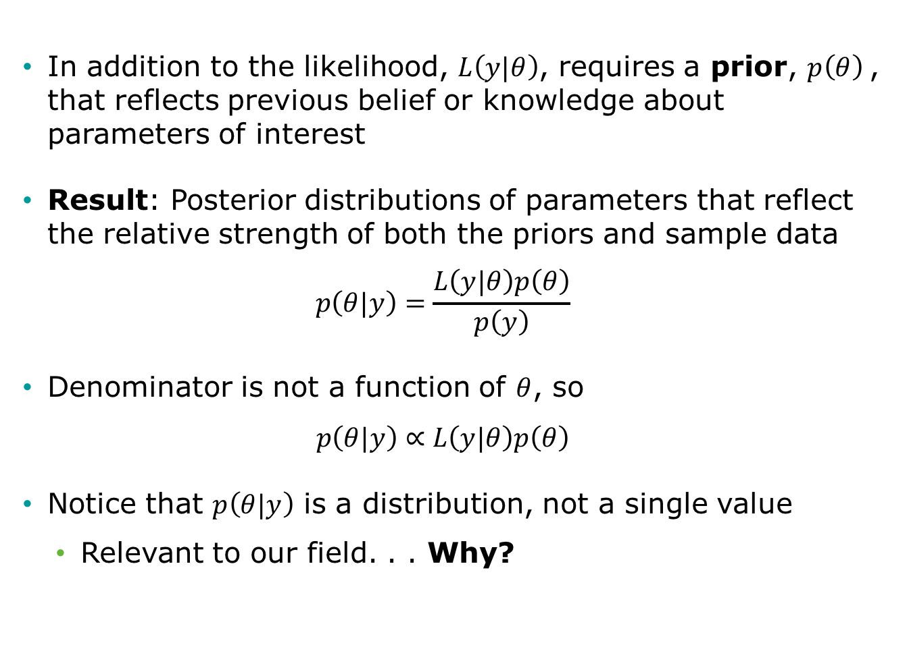
Bayesian setup
In addition to the likelihood, $L\left(y|θ\right)$, requires a prior, $p\left(θ\right)$, that reflects previous belief or knowledge about parameters of interest
Result: Posterior distributions of parameters that reflect the relative strength of both the priors and sample data
$$p\left(θ|y\right)=\frac{L\left(y|θ\right)p\left(θ\right)}{p\left(y\right)}$$
Denominator is not a function of $θ$, so
$$p\left(θ|y\right)∝L\left(y|θ\right)p\left(θ\right)$$
Notice that $p\left(θ|y\right)$ is a distribution, not a single value
Relevant to our field. . . Why?
Notes:
-Frequentist: the data observed is the random variable.
-Bayesian: the parameters are random variables (and the data is fixed – our targets). Likelihood is not a probability (not bounded between 0 and 1) – the likelihood that a set of outputs we see (targets) was generated from a given data generation process (prior parameters and our assumptions about the distribution).
-Prior is based on existing (prior) knowledge about a parameter (we know something about it from a previous study, or we know that a probability is between 0 and 1).
-NM focuses on L(y|θ) only.

Slide 29

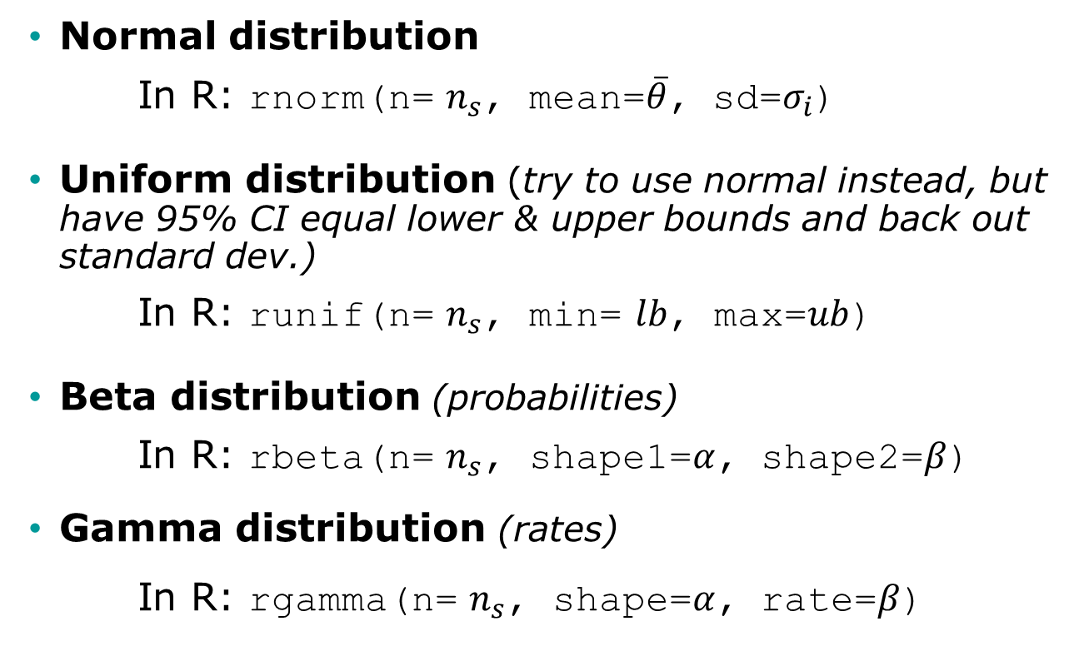
Commonly used prior distributions to sample $n_{s}$ values
Normal distribution
In R: rnorm(n= $n_{s}$, mean=$\overline{θ}$, sd=$σ_{i}$)
Uniform distribution (try to use normal instead, but have 95% CI equal lower & upper bounds and back out standard dev.)
In R: runif(n= $n_{s}$, min= $lb$, max=$ub$)
Beta distribution (probabilities)
In R: rbeta(n= $n_{s}$, shape1=$α$, shape2=$β$)
Gamma distribution (rates)
In R: rgamma(n= $n_{s}$, shape=$α$, rate=$β$)
Notes:
We’re just using uniform distributions in our example for simplicity

Slide 30
Pros and cons
Pros: We obtain distributions of parameters rather than only point estimates
Cons: “Harder” to implement than other methods? Mmm not really!

Slide 31
Obtaining a posterior distribution
Analytically
Not feasible for simulation models
Markov chain Monte Carlo (MCMC)
Sampling methods (nice because we can use parallel computing to increase speed):
Sampling Importance Resampling (SIR)
Incremental Mixture Importance Sampling (IMIS)
Notes:
Also Hamiltonian Monte Carlo

Slide 32
Markov chain Monte Carlo (MCMC)
Simulates posterior distribution by jumping in the parameter space in a Markovian fashion
The transition matrix of the Markov chain is proposed using a proposal distribution
There are numerous algorithms that implement MCMC, including Metropolis-Hastings (MH)
R has some packages that implement MCMC algorithms
Other R packages interface with external MCMC software, including WinBUGS and JAGS
Example of MCMC
Notes:
Similar to Nelder Mead (goal is to find a peak) but samples from normal distribution to move to next point rather than using simplex. Discards the next sample if it isn’t an improvement on the previous one. Weakness: each chain has to be sequential (moves from one point to the next), although you could run multiple chains at once…

Slide 33
Markov chain Monte Carlo (MCMC)
Pros:
“Theoretically”" will eventually converge to the “true” posterior distribution
Cons:
Computationally intensive
Autocorrelation is a problem with simulation models and therefore requires a high number of samples
Use of external software (WinBUGS, JAGS), requires implementing the model within that software’s syntax (really slow to do this in R)

Slide 34
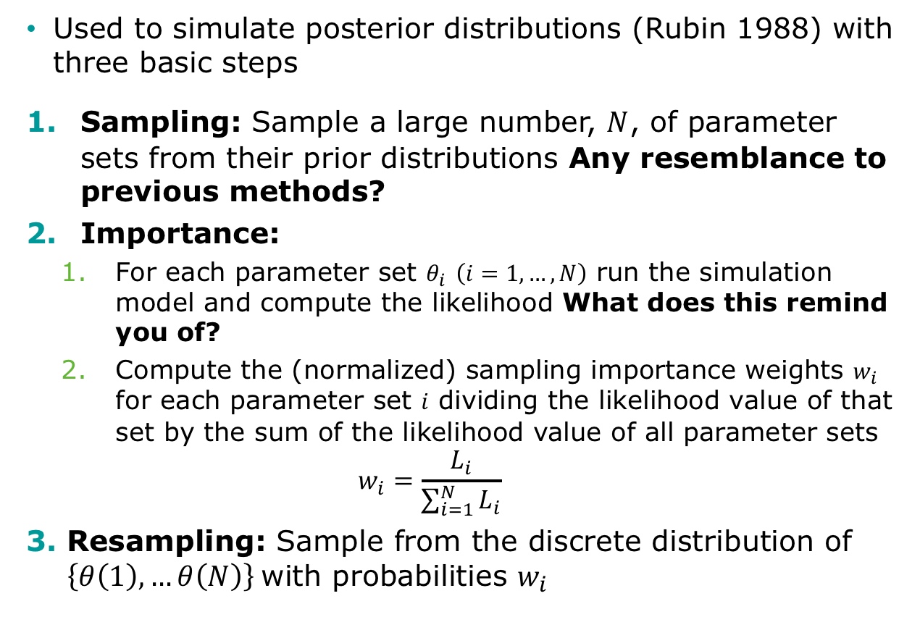
Sampling Importance Resampling (SIR)
Used to simulate posterior distributions (Rubin 1988) with three basic steps
Sampling: Sample a large number, $N$, of parameter sets from their prior distributions Any resemblance to previous methods?
Importance:
For each parameter set $θ_{i}$ $\left(i=1,…,N\right)$ run the simulation model and compute the likelihood What does this remind you of?
Compute the (normalized) sampling importance weights $w_{i}$ for each parameter set $i$ dividing the likelihood value of that set by the sum of the likelihood value of all parameter sets
$$w_{i}=\frac{L_{i}}{\sum_{i=1}^{N}{L_{i}}}$$
Resampling: Sample from the discrete distribution of $\left\{θ\left(1\right), …θ\left(N\right)\right\}$with probabilities $w_{i}$
Notes:
The reason this is considered Bayesian is that we are using the Likelihood to determine the likelihood of sampling that parameter set

Slide 35
Incremental Mixture Importance Sampling (IMIS)
SIR can miss areas of high posterior probability as the number of parameter increases (one parameter set can start to dominate)
IMIS addresses limitations of SIR and was proposed by Teele (2006)
Starts with a modest-size SIR
Then, explores parameter space by iteratively adding a multivariate normal distribution centered at the point with the highest importance weight to the current importance sampling distribution
At the end, posterior becomes a mixture of such functions and of the prior

Slide 36
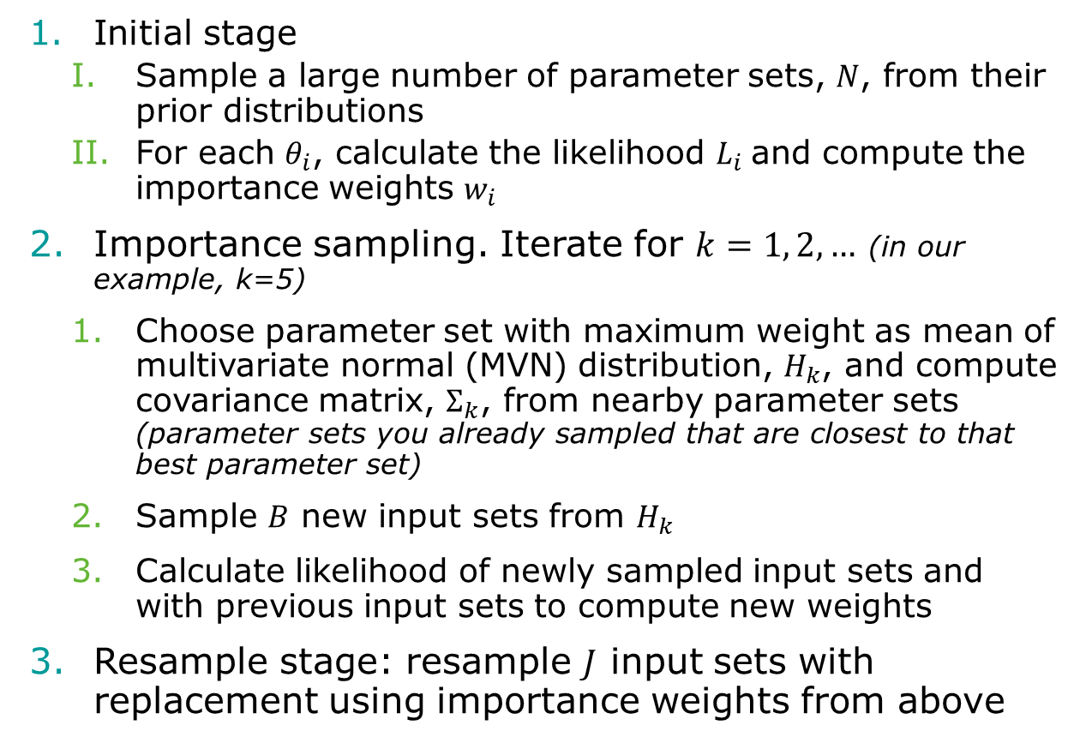
Incremental Mixture Importance Sampling (IMIS)
Initial stage
Sample a large number of parameter sets, $N$, from their prior distributions
For each $θ_{i}$, calculate the likelihood $L_{i}$and compute the importance weights $w_{i}$
Importance sampling. Iterate for $k=1, 2, …$ (in our example, k=5)
Choose parameter set with maximum weight as mean of multivariate normal (MVN) distribution, $H_{k}$, and compute covariance matrix, $Σ_{k}$, from nearby parameter sets (parameter sets you already sampled that are closest to that best parameter set)
Sample $B$ new input sets from $H_{k}$
Calculate likelihood of newly sampled input sets and with previous input sets to compute new weights
Resample stage: resample $J$ input sets with replacement using importance weights from above
Notes:
The reason this is considered Bayesian is that we are using the Likelihood to determine the likelihood of sampling that parameter set

Slide 37
Incremental Mixture Importance Sampling (IMIS) Inputs
B: incremental sample size at each iteration of IMIS
B.re: number of draws from the posterior
number_k: maximum number of iterations in IMIS (start w/ ~10 to make sure it’s working)
Notes:
As opposed to MCMC: each sample could be evaluated in each of the cores (using parallel computing)

Slide 38
Incremental Mixture Importance Sampling (IMIS) Outputs
resamples: draws from the posterior distribution
stat: diagnostic statistics at each IMIS iteration
MargLike:
UniquePoint: expected number of unique points among resamples
MaxWeight: maximum importance weight
ESS: effective sample size (the closer to B.re, the better)
center: center of Gaussian components

Slide 39
R Session
Notes:
Part 1 = Showing code 3 state model
Part 2 = Exercise build Sick-Sicker model
Part 3 = Show answers of Sick-Sicker

